Slide 1
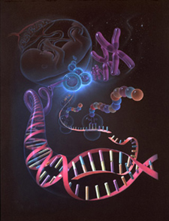

Slide 2
Tracking the Human Genome
Barry Smith
March 2005

Slide 3
Two parts
some background to the Human Genome Project, its possibilities and its problems
should you change your own genome?

Slide 4
Part I: The Human Genome Project
Completed in 2003
Goals:
  identify all the approximately 20,000-25,000 genes in human DNA,
  determine the sequences of the 3 billion chemical base pairs that make up human DNA,
  store this information in databases,
  improve tools for data analysis,
  transfer related technologies to the private sector, and
  address the ethical, legal, and social issues (ELSI) that may arise from the project.

Slide 5
Genome = All of the DNA for an organism

Slide 6
What does DNA do?
DNA = cookbooks for making and running all living things
The recipes (genes) determine whether you’re a man or a woman, your eye color, how many arms and legs you have, how many wings and tentacles you have.
Exact copy of entire set of cookbooks (= chromosomes) contained in nuclei of almost all your cells
23 pairs of chromosomes in each cell
25,000 genes = recipes for making proteins, which do almost everything in the cell
– they give you energy, digest your food, increase your sex drive (hormones are proteins) and help you fight off infections (antibodies are proteins).
DNA → messenger RNA → proteins

Slide 7
Complexity
About 25,000 genes in a human
100-200,000 proteins
Individual variation in most genes
100s of cell types
100,000s of disease types

Slide 8
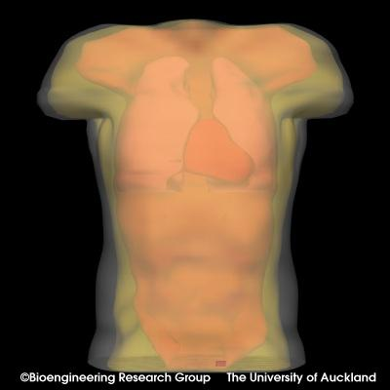
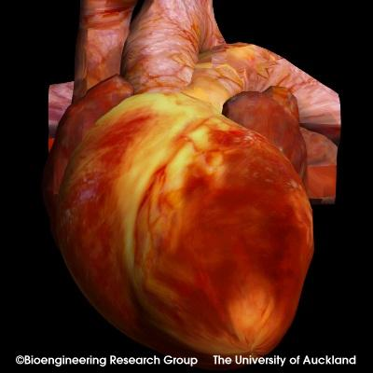
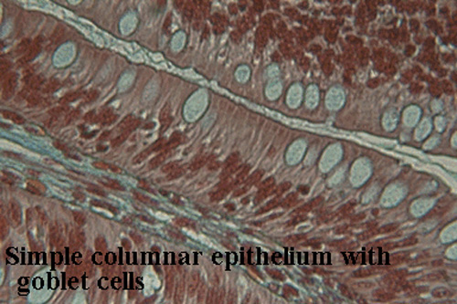
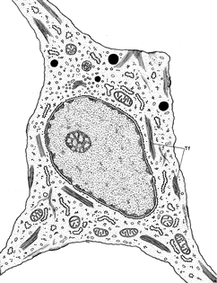
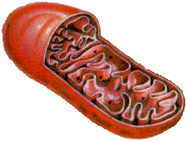
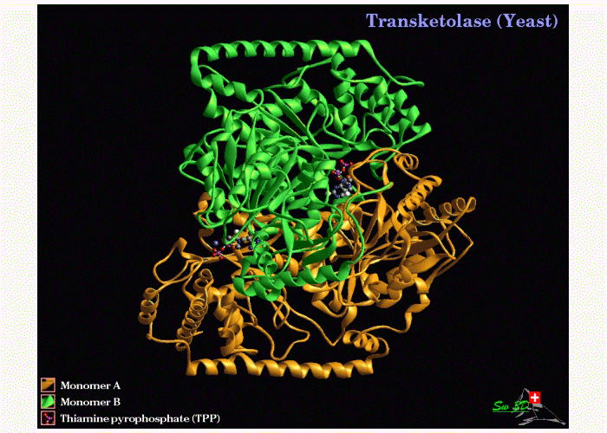
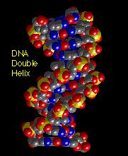
Scales of anatomy
Organism
Organ
Tissue
10⁻¹ m
Cell
Organelle
10⁻⁵ m
Protein
DNA
10⁻⁹ m

Slide 9
Genetic Census: UK Biobank
Kinkead, NY Times: Dec 31, 2002
1.2M healthy individuals ages 45-69 yrs will contribute blood specimens
  DNA will be prepared and frozen
500,000 individuals will be chosen to be followed for 10 yrs through NHS records
At intake
  10 page comprehensive questionnaire
  10 day diet diary
  Brief health exam

Slide 10
Biomedical Ontology
Each (clinical, pathological, genetic, proteomic, pharmacological …) information system uses its own terminology and category system
biomedical research demands the ability to navigate through all such information systems
How can we overcome the incompatibilities which become apparent when data from distinct sources is combined?

Slide 11
How overcome incompatibilities between different scientific terminologies?
immunology
genetics
cell biology

Slide 12
Example: Gene Names
Genes are mapped at such a speed that just naming them is hard work
HUGO (Human Genome Organization) nomenclature committee
– attempts to overcome the incompatibilities within one and the same discipline of genetics

Slide 13
Human gene names
TNFRSF1
tumor necrosis factor receptor subfamily, member 1B
also known as TNFR2, TNFBR, TNFR-75 kD, TNFR-80 kD, p75TNFR, p75 and CD120b.
SEMA5A
sema domain, seven thrombospondin repeats (type 1 and type 1-like), transmembrane domain (TM) and short cytoplasmic domain, (semaphorin) 5A

Slide 14
Finding new genes
e.g. through work on a hereditary disease: a change in a gene (a mutation) causes symptoms and thus hints at the existence of the gene. The gene may then be named according to the disease:
BRCA1 (breast cancer gene 1)
BRCA2 (breast cancer gene 2)

Slide 15
Genes are molecules
Genes can be found by reading through the DNA strands of the mapped genome, even before we know what their functions are
And there is no standardized representation of molecule names

Slide 16
Naming genes
Human genes usually have names like SLC26A3 (solute carrier family 26, member 3).

Slide 17
Fly gene names are more creative
groucho (yields more bristles on face)
ken and barbie (both male and female mutants lack external genitalia)
maggie (arrests development, after Maggie Simpon)
cheap date (mutants are especially sensitive to alcohol)
dreadlocks (connections between the nerve cells are screwed up in dreadlock style)

Slide 18
Fly gene names
sunday driver (messes up intracellular traffic)
ring
(“Really Interesting New Gene”)
swiss cheese (mutant flies' brains have swiss-cheese-like holes)

Slide 19
Gene names should ideally express the function or significance of the gene
Sometimes a gene is found and named several times before the researchers realize that they are working with the same gene.
e.g. in plants:
superman (produces extra male genitals in flowers)
clark kent (like superman, but more wimpish)
But clark kent not a separate gene but just another form of superman

Slide 20
Many, many obstacles to the full realization of all the promise of the Human Genome Project

Slide 21
but still genetics and genomics are already affecting your life
Forensics
DNA fingerprinting
paternity testing
Genetic counselling

Slide 22
Genetic engineering
oil-eating bacteria
genetically modified plants resistant to insects
ice-minus plants resistant to frost
tastier tomatoes
sheep producing milk with useful proteins (cloning)
On the way:
drought-tolerant plants
microbes that convert biomass to fuels
pigs with hearts safe for transfer to humans
cloning of humans (fertility treatment, but health risks)

Slide 23
Designing new drugs
Micro-arrays of genes on chips allow us to measure the activity of thousands of genes to investigate the effects of drugs on specific patients
Individualized (molecular) medicine

Slide 24
Designing new organisms
gene splicing
small pieces of DNA are inserted into the host DNA yielding new creatures

Slide 25
A new kind of evidence-based medicine
  science vs. art
  protocols
  controlled experiments
  huge amounts of data
  molecules
  computer algorithms
  better prevention

Slide 26
Personalized medicine I
drugs tailored to your genetic make-up
improved efficacy
reduced side-effects
gene therapy
the addition of new genes to existing humans
still problems with severe side-effects

Slide 27
Personalized medicine 2
rapid diagnosis of pathogens
  bacteria
  viruses
  parasites
  at the point of care

Slide 28
Personalized medicine 3
home genetic testing (the $1000 genome)

Slide 29
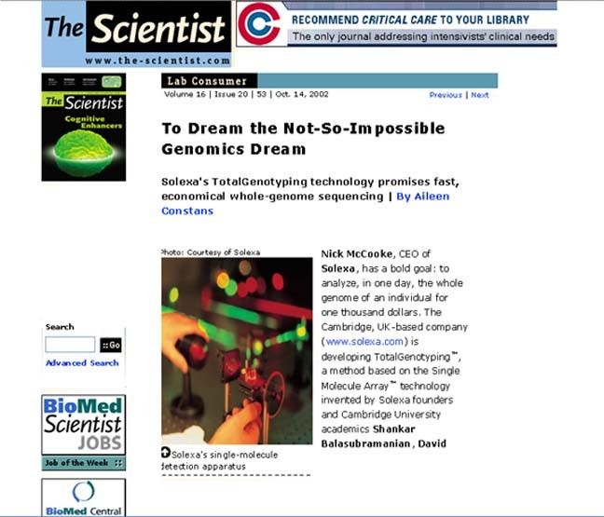

Slide 30
Personalized medicine 3
home genetic testing (the $1000 genome)
your boss can do it
your insurance company can do it
your boyfriend can do it
Too much knowledge can be a dangerous thing
Do you want to know now when, and how,
you will die?

Slide 31
Predicting your life
What sort of person will you be?
A map of your baby’s genome + computer tools will allow you to infer what sorts of interests, fears, strengths and weaknesses your baby will have, what sorts of diseases she will be susceptible to, and what sorts of drugs will cure them.

Slide 32
Some problems
It will never be the case that by reading the tea leaves of your genome you can predict your life.
Identical twin studies show that 50% of the variance in personality is environmental.
You could design a human being only by rigorously and continuously controlling the environment.

Slide 33
Some problems
In the developing human being from fertilization to the early twenties genome and environment are in an intimate dance.
The genome is constantly bouncing ideas off the environment and the environment’s response powerfully effects genomic development.

Slide 34
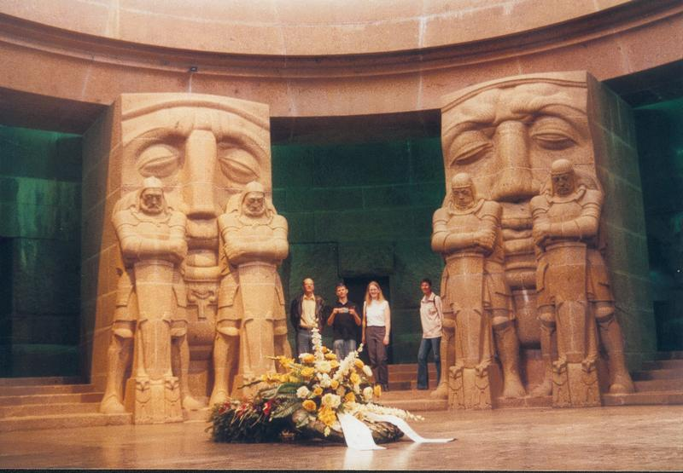

Slide 35
Part Two
Changing the genome

Slide 36
Build your own human
first stage: build better drugs, better foods (transgenic grains)
decrease in the prevalence of common complex diseases
eliminate some diseases by eliminating our susceptibility

Slide 37
Build your own human
next stage
genomics will give us a complete list of parts and of the directions for assembling a fully functioning organism
through genetic manipulation we could create designer human beings, who would grow up to have just those features we would like them to have

Slide 38
Should we change the human genome?
Building the superman
Breeding out aggression?
Gradually: eliminate crime and other forms of social deviance
Posthumanism

Slide 39
Humankind has been changing itself through technology for 1000s of years
Fire, cooking
The wheel
Clothing
Jewelry, cosmetics, false teeth
Medicines, heart pacemakers
Coffee

Slide 40
Humankind has been changing itself through technology for 1000s of years
Writing, The Bible, Codes of Law
Diaries, calendars, clocks and watches
Radio and TV
Laptops and LCD projectors

Slide 41


Slide 42
Should you change your own genome?
if are you (chronically) unhealthy
if are you (painfully) abnormal
if you are healthy and normal

Slide 43
Should you change your own genome?
if are you (chronically) unhealthy
if are you (painfully) abnormal (in ways which could be genetically fixed)
if you are healthy and normal

Slide 44
Should you change your own genome?
if are you (chronically) unhealthy
if are you (painfully) abnormal (in ways which could be genetically fixed)
if you are healthy and normal

Slide 45
What does ‘healthy’ mean?
World Health Organization:
Health is the state of psychological and physical well-being of humans
Should you change your own genome to overcome depression?

Slide 46
Biostatistical Definition
Health = conformity to normal species design (as statistically determined)
Should you change your own genome because you are below average height?
Notes:
Illness, but not Health and Disease, is regarded as normative. This is probably the most common view among physicians.
What kind of definitions these are, I will soon discuss.
Remember what is said in the last sentence, even though I will not pay attention to it, it relates medicine to the rest of society.

Slide 47
Should you change your own genome
...because you don’t play the piano very well?
...because you want to live to be 200? 2000?
...because you want to get rid of your violent tendencies?
...because you want to grow wings?
...because you just want to be constantly blissfully happy?

Slide 48
Why not?
If we are just biochemical systems, the products of our genes?

